Slide 1
Smart Pantry
Rishabh Misra

Slide 2

Technological Motivation - Internet of Things
Increased relevance of Internet of Things
Pantries left behind in advancement

Slide 3
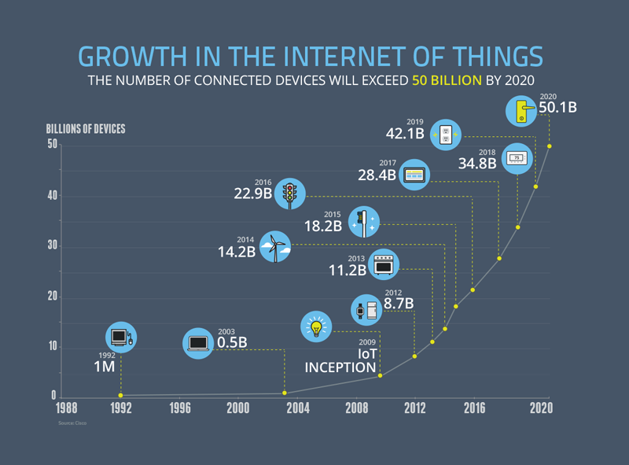

Slide 4
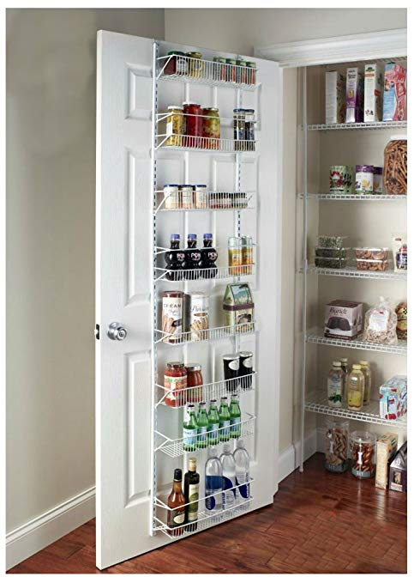
Personal Motivation
I often don’t remember what runs out in pantry, or even at times what is in the pantry
Going to college - need to manage pantry

Slide 5

What is needed
Easy way for people to track food items within pantries
Accessibility in order to improve user efficiency
Internet connectivity w/ other IoT devices

Slide 6


Proposal
I propose creating a visual processing system that uses a camera to observe what is in a pantry at certain times, noting the specific products and the prevalence of each.
How I’m going to solve this problem

